Slide 1


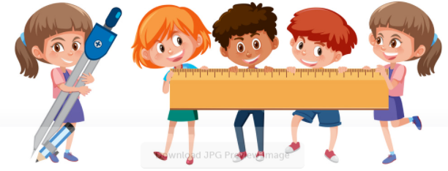
PARENTS MATHS WORKSHOP
Year 1

Slide 2

Aims of the Session:
Share with you some of the things your child will be learning in school
Improve your confidence in helping your child with maths
Explore some games and activities you can play with your child at home to help them develop fluency and become more automatic with number facts.

Slide 3
Why engage with your child’s learning?
Research evidence suggests that when parents are engaged in their children’s learning, outcomes for children can be improved.

Slide 4






Mastering Number Programme…
In Reception, Year 1 and Year 2 we follow a mastering number programme.
This will help your child to develop good number sense.
Some of the things they will learn includes:

Slide 5
How will knowing how numbers are ‘made’ help?
If children know that 4 can be made of 3 and 1, they can apply this knowledge later on to see that:
30 and 10 is 40
300 and 100 is 400
and that;
400 take away 100 is 300

Slide 6
How will knowing how numbers are ‘made’ help?
If children know that 5 can be made of 2 and 3, they can apply this knowledge later on to see that:
188 + 5 = 193
2 3

Slide 7
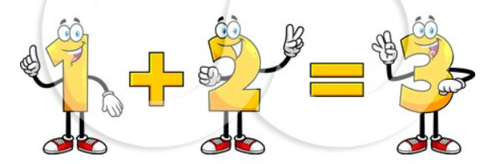
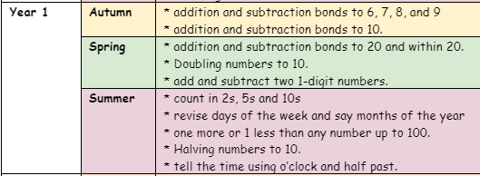
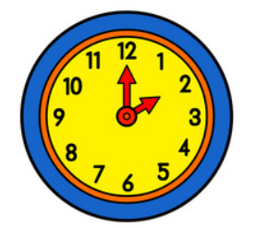
Developing Fluency:

Slide 8
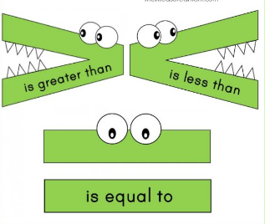
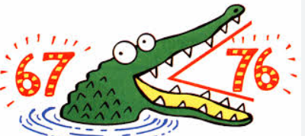
Comparing numbers
The greedy croc eats the largest number!

Slide 9
Counting backwards
Using music
Hide and seek
Use different voices - alien, ghosts, robots
Take in turns - like a tennis match
Start on different numbers

Slide 10
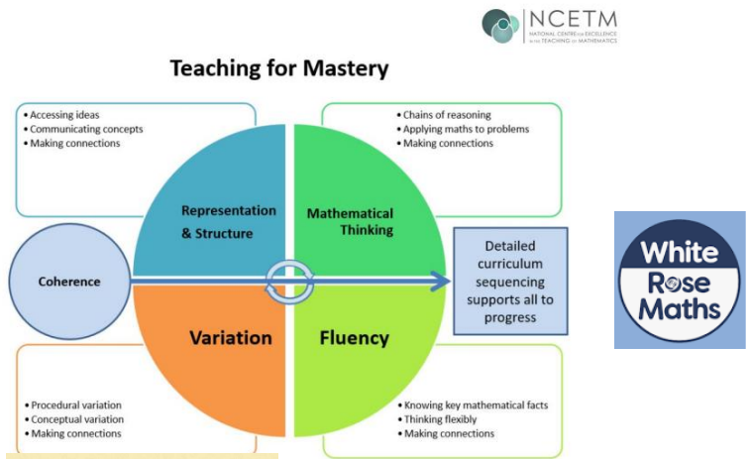

Slide 11
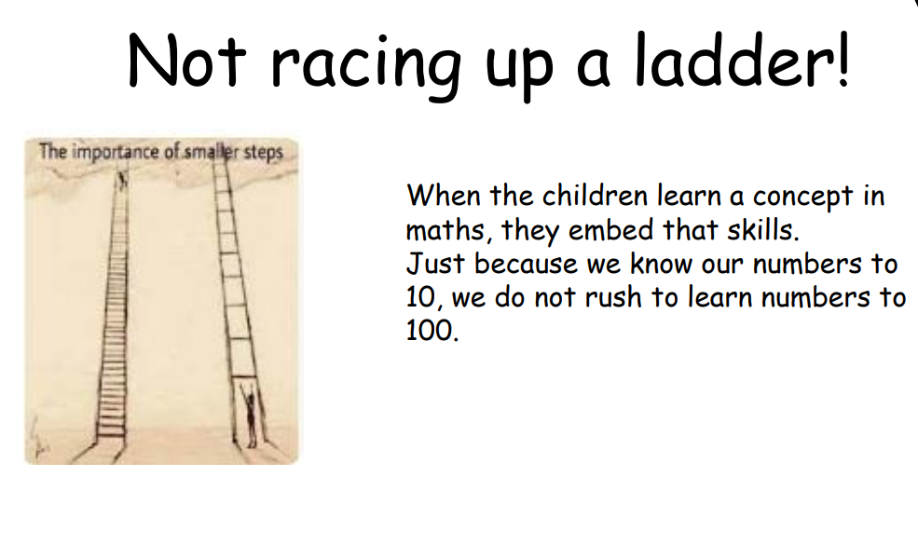
Not racing up a ladder!
When the children learn a concept in maths, they need time to embed the skills.
Just because they know numbers to 10, it is important that we don’t rush to learn numbers to 100.

Slide 12
CPA - approach to maths!
Concrete
Pictorial
Abstract

Slide 13

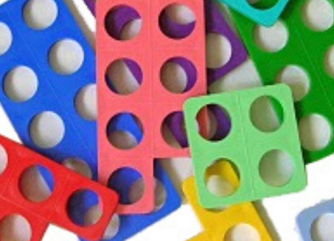
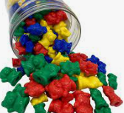
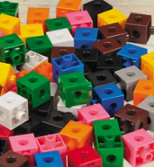
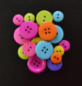
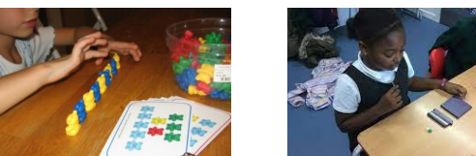
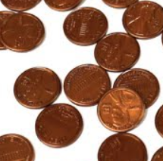
CPA - approach to maths!
Concrete

Slide 14
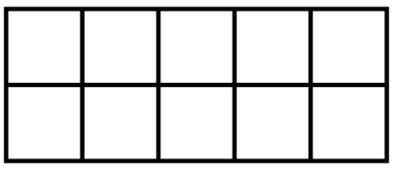
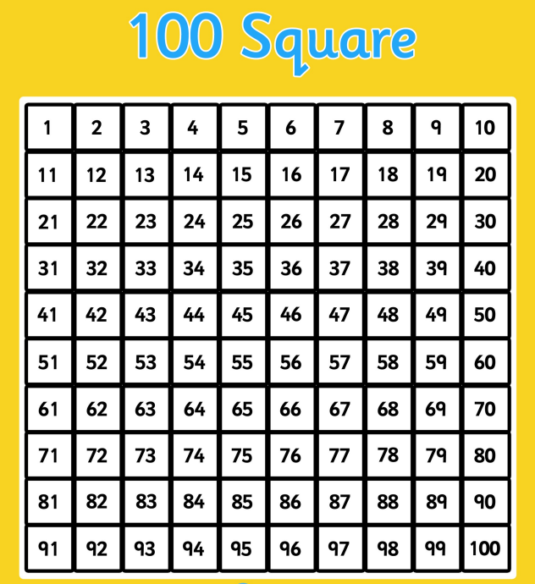
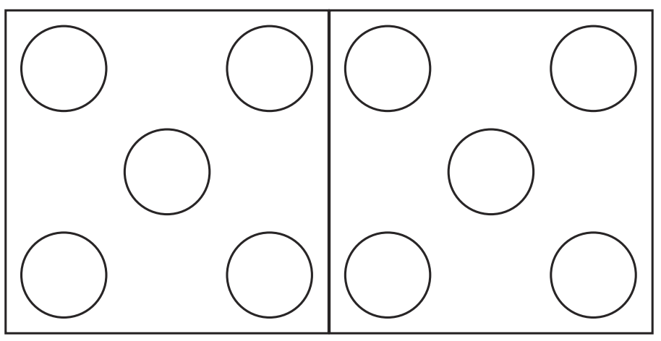

Slide 15
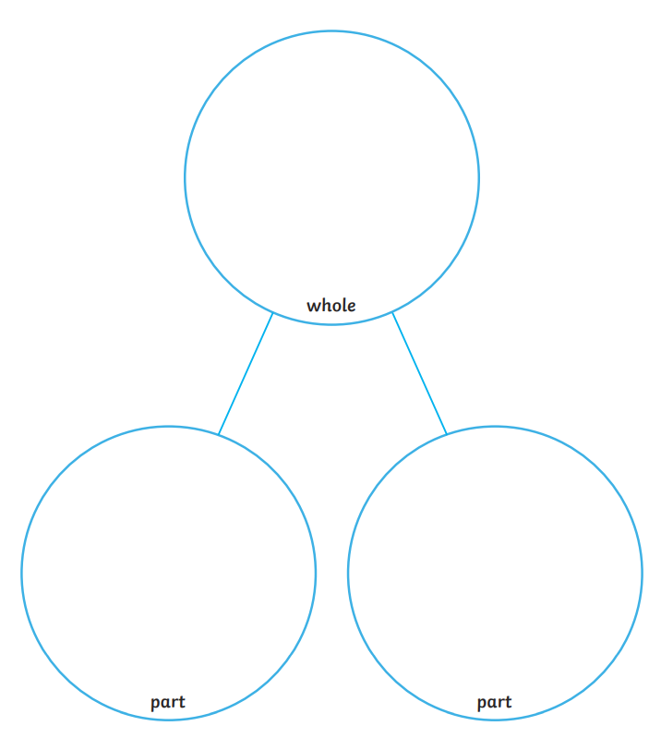

Slide 16

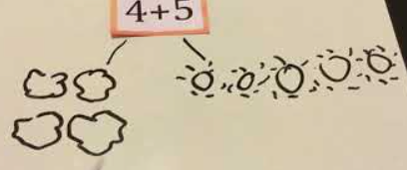
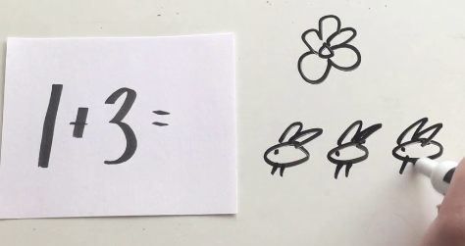
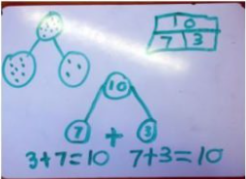
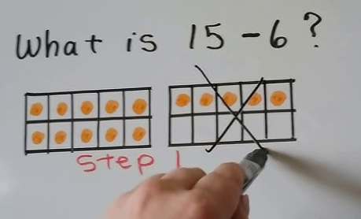
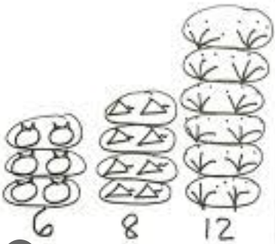
CPA - approach to maths!
Pictorial

Slide 17

CPA - approach to maths!
Abstract

Slide 18
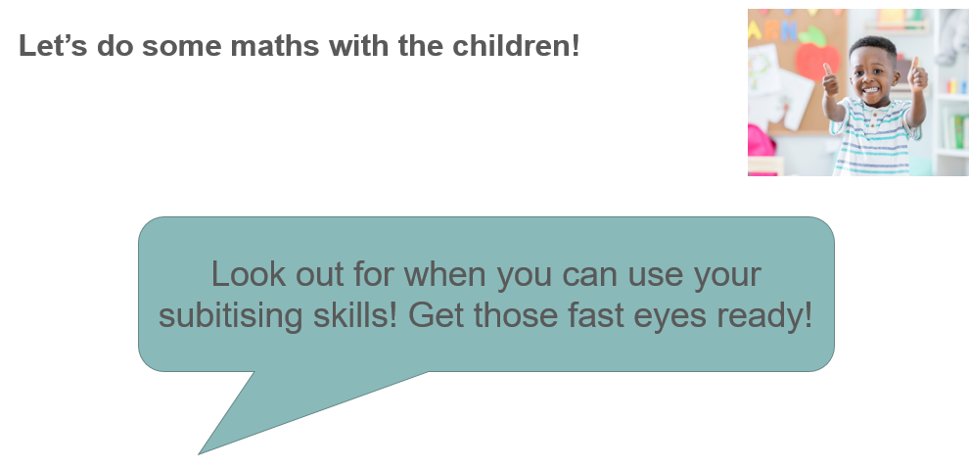
Year 1 builds on the children’s subitising skills from Reception.

Slide 19
Subitising
Subitising is the ability to recognise a small quantity of objects without the need to count.
It helps the children to understand the composition of number.

Slide 20
Notes:
Take suggestions briefly.
Why was that harder?
There were too many for our brains to recognise instantly (or subitise).
Let’s try again… Children and adults can have a go for the next few slides.
This time, can you show me on your fingers as well as saying the number? Using fingers to ‘show’ a number is another way we work with children to help them understand numbers.
Encourage both adults and children to show their fingers for the numbers shown.

Slide 22
Notes:
How many were there this time?
What helped?
Seeing the pattern in the shape of the die face is something that can support subitising.
How about this time?

Slide 24
Notes:
How many? Again that familiar pattern helps, but can we tell when they are not in that familiar pattern?

Slide 26
Notes:
How many this time?
Most of you managed to see four even though they were not in that special pattern. We are used to seeing a square four like on a die, but you still recognised it.
What did you see?
A two and a two and you automatically know that is four.

Slide 27

Subitising
Sometimes when we subitise we can see two groups at once; if we know that 3 can be ‘made’ of 2 and 1, then we know how many there are altogether without counting.

Slide 28
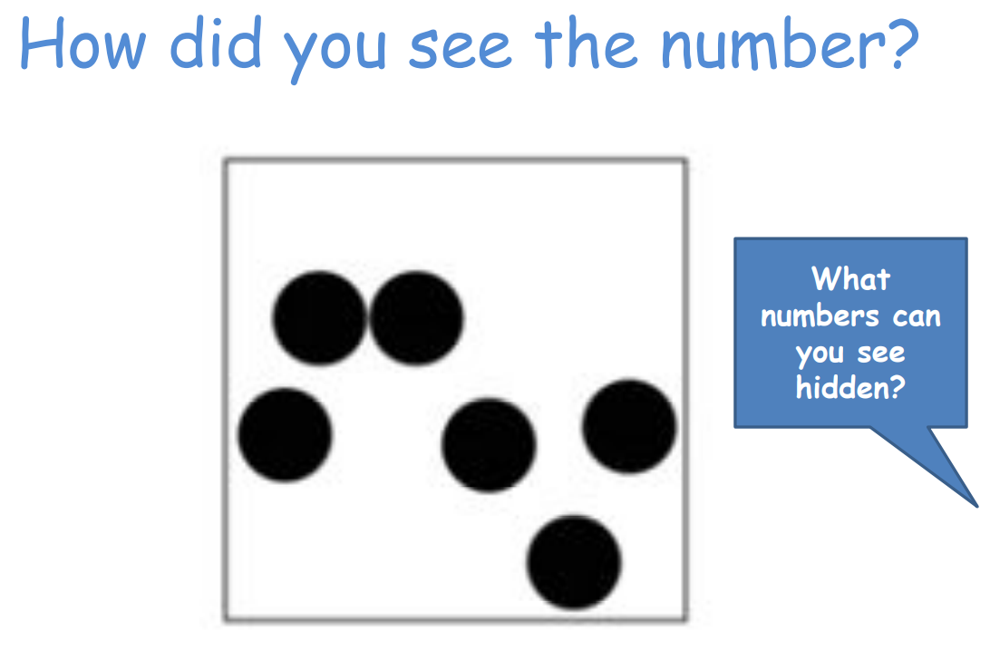

Slide 29
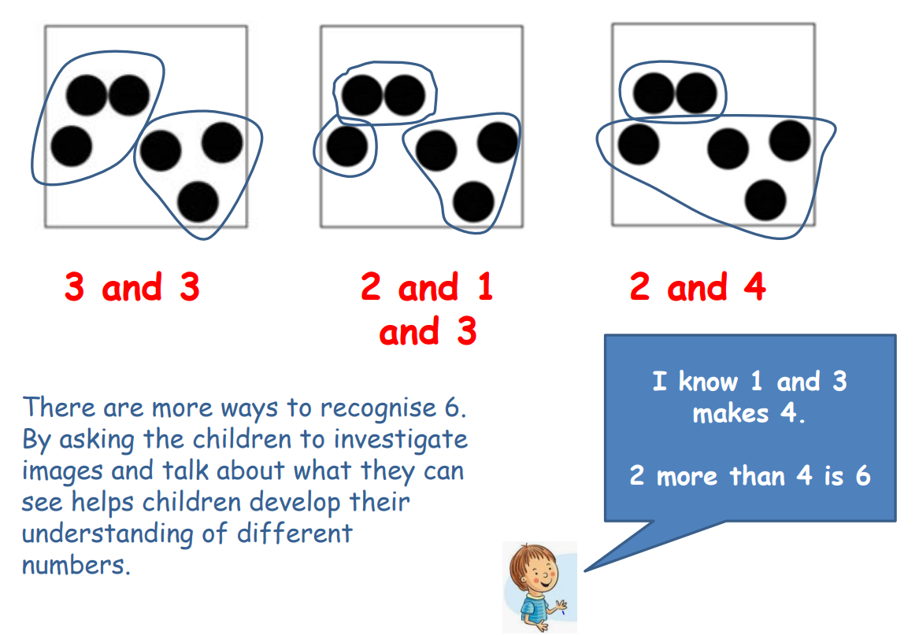

Slide 30
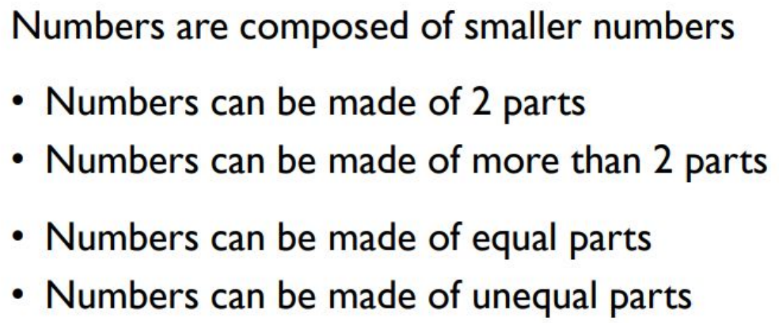
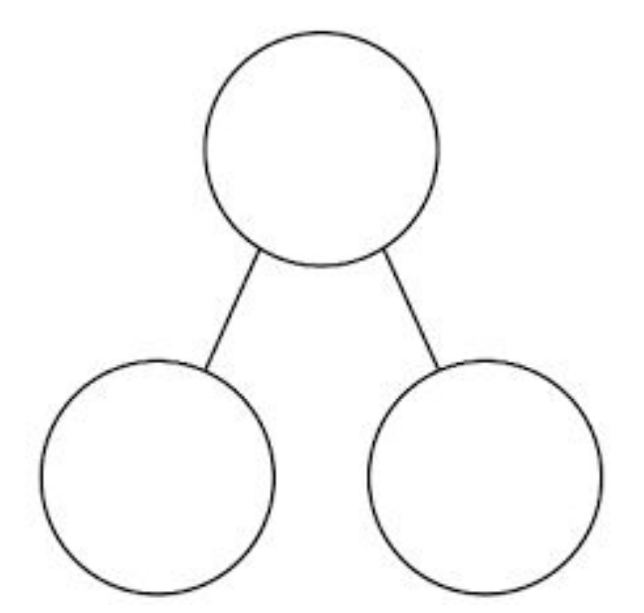
Composition of number
We teach the children about the composition of number.

Slide 31
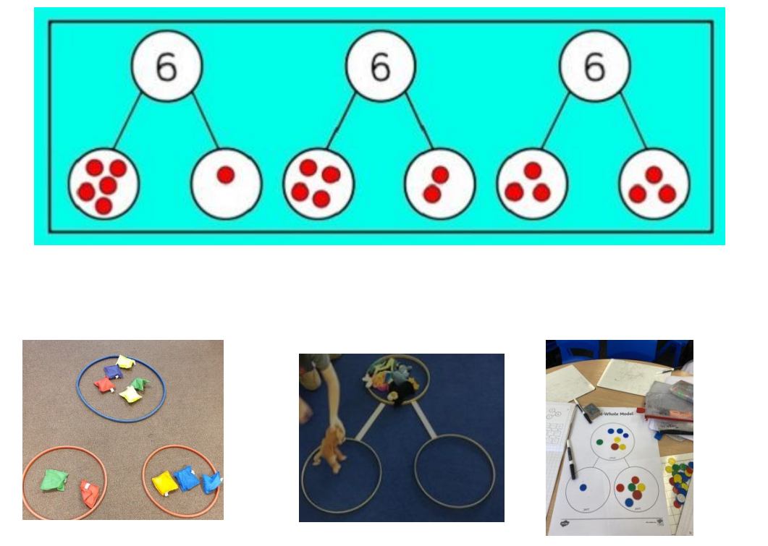

Slide 32
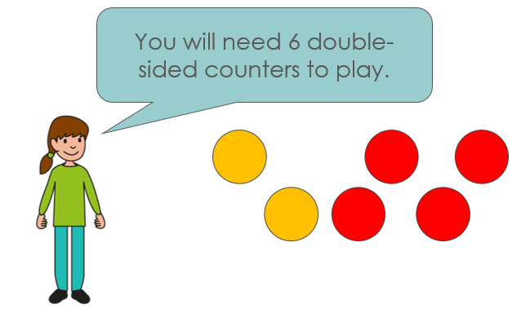
Drop the Counters!

Slide 33
6 is made up of ……… and ………..
……… and ………. make 6!

Slide 34
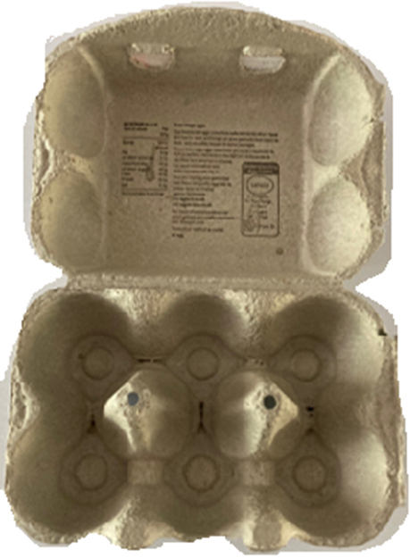
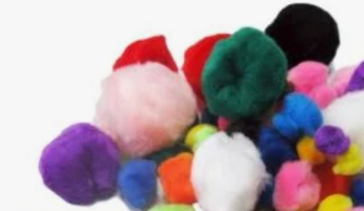
At home you could use egg boxes!

Slide 35
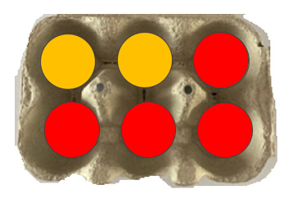
6 is made up of ……… and ………..
……… and ………. make 6!

Slide 36
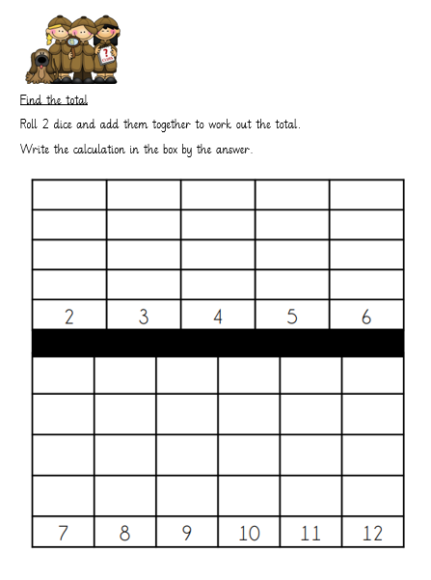
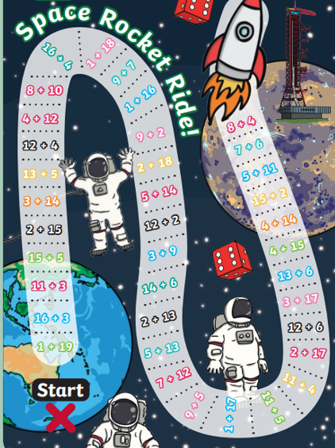
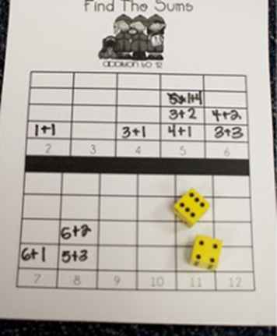
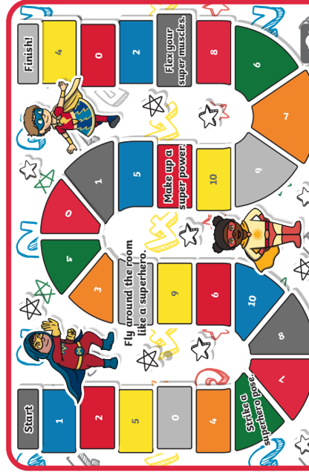
Addition Games
One more than

Slide 37
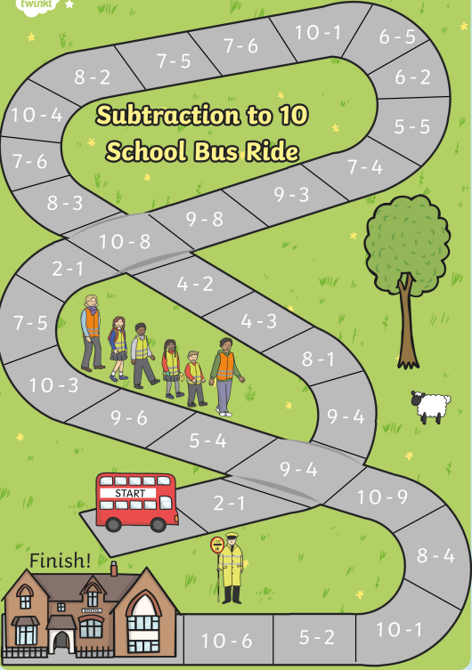
Subtraction Games
Counting backwards
One less

Slide 38
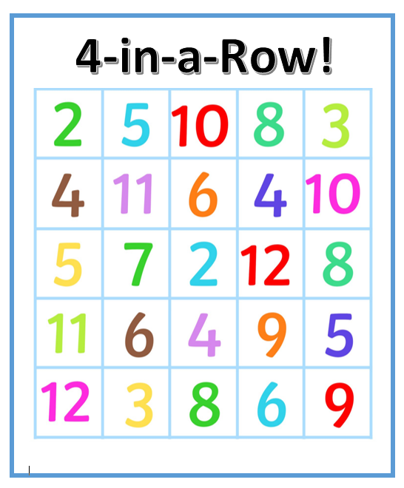
Developing Fluency

Slide 39
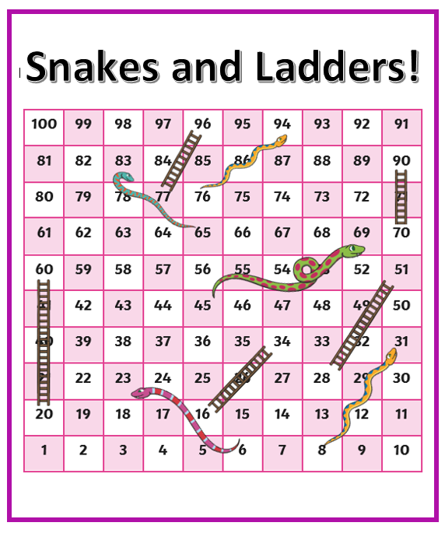
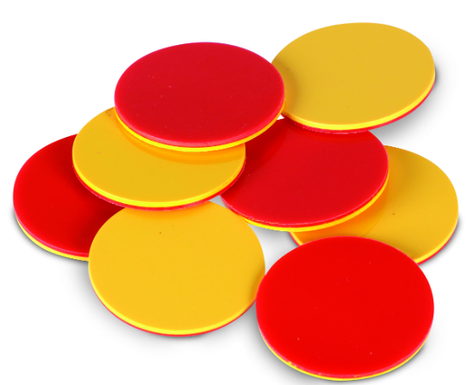
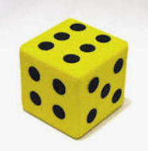
Recognising numbers to 100!

Slide 40
NUMBER FORMATION

Slide 41
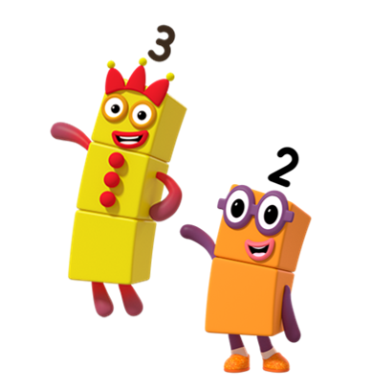
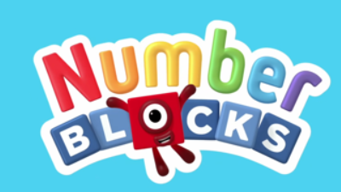
Number Blocks!

Slide 42
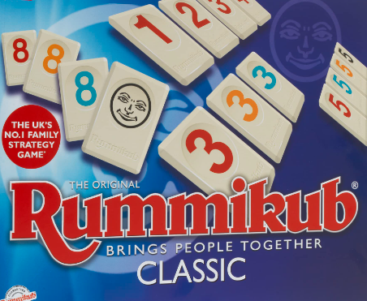

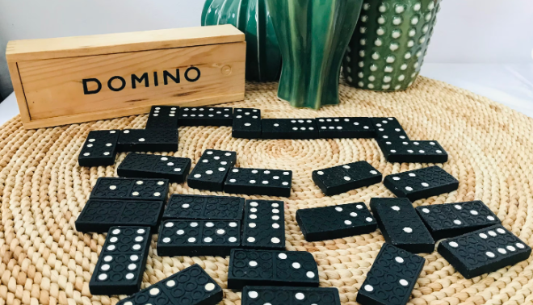
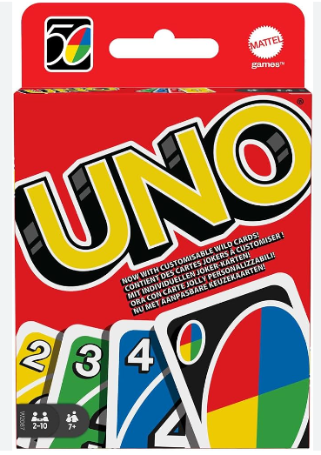
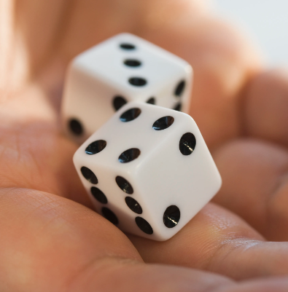
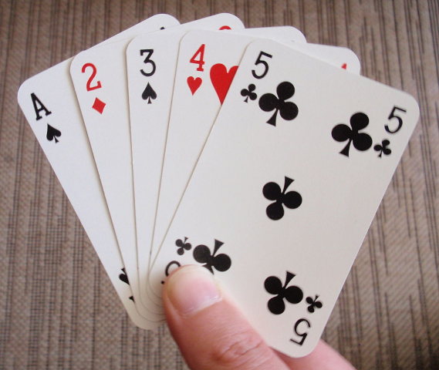
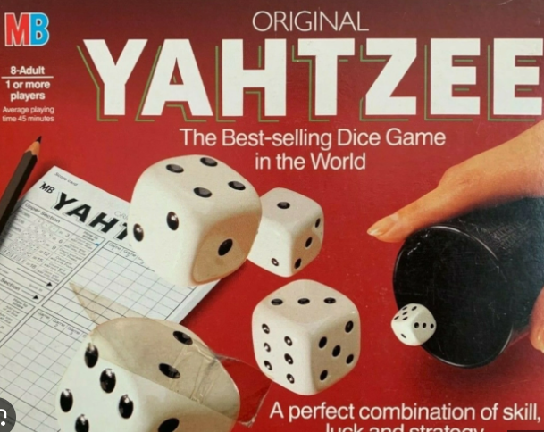
Games you can play at home!

Slide 43


Card Games:

Slide 44


Doodle Maths

Slide 45



Doodle Maths

Slide 46


Numbots

Slide 47


